Slide 1
LUMOS
An improved approach to
protecting sensitive information through web browsers
Notes:
Hello! This is our presentation

Slide 2

Being able to securely enter sensitive information into websites is crucial to software users and developers.
Notes:
This is our motivation for the project or the problem we are looking to address.

Slide 3
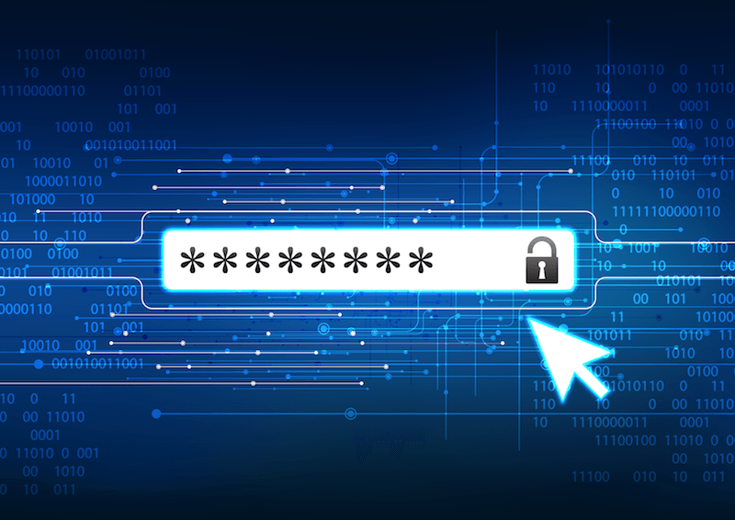

Sensitive data, like passwords or SSNs, can enable malicious attacks by fraudulent users that hurts users and businesses
Notes:
Sensitive data can enable fraudulent users to access financial information, medical records, etc. They can perpetrate credit card or identity fraud, which hurts businesses and people.

Slide 4

Notes:
Malicious attackers and key loggers caused over a billion dollars of bitcoin to be stolen in 2018.

Slide 5
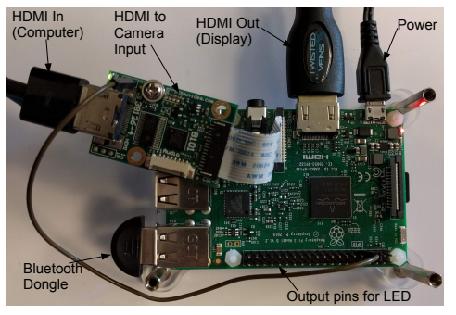
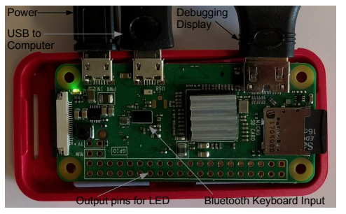
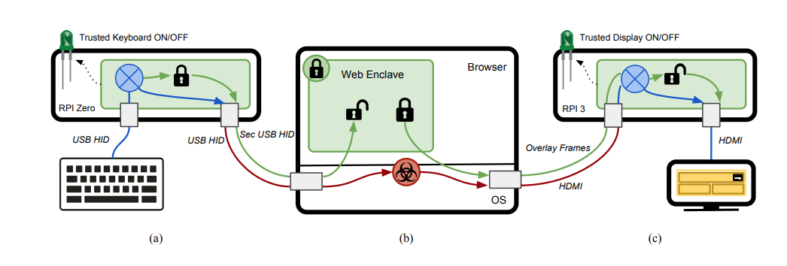
FIDELIUS
Difficult for developers​
Difficult for users​
User-dependent efficacy​
[1] Eskandarian, Saba, et al. "Fidelius: Protecting user secrets from compromised browsers." 2019 IEEE Symposium on Security and Privacy (SP). IEEE, 2019.
Notes:
Difficulty for users lies in the setup of all the hardware. Developers have a difficult time with deprecated libraries and systems as well as matching out-of-date hardware. The efficacy of the system relies on users following cues from raspberry pi lights indicating system security.

Slide 6

Introducing Lumos
A Simpler Way to Do Things

Slide 7
Goals for Lumos
Easier to use and setup than Fidelius
More secure
than Fidelius
More assessible/portable than Fidelius

Slide 8
Lumos Design
Thin Client
replaces (a) and (c)
VNC/Remote Desktop
Host
Replaces (b)
Lumos REST API (over HTTPS)
User Input
Display Out
Keyboard
Display
Wireless
Wired
Greatly simplified architecture
“Thin client architecture” with Lumos additions

Slide 9
Lumos Design
Normal Web Browsing
Authentication
Thin Client
replaces (a) and (c)
VNC/Remote Desktop
Host
Replaces (b)
Session Cookies→
←URL
User Input
Display Out
*No Enclave – Secure processing happens on client
Keyboard
Display
Wireless
Wired
Move secure processing to Thin Client
No more enclaves/SGX

Slide 10

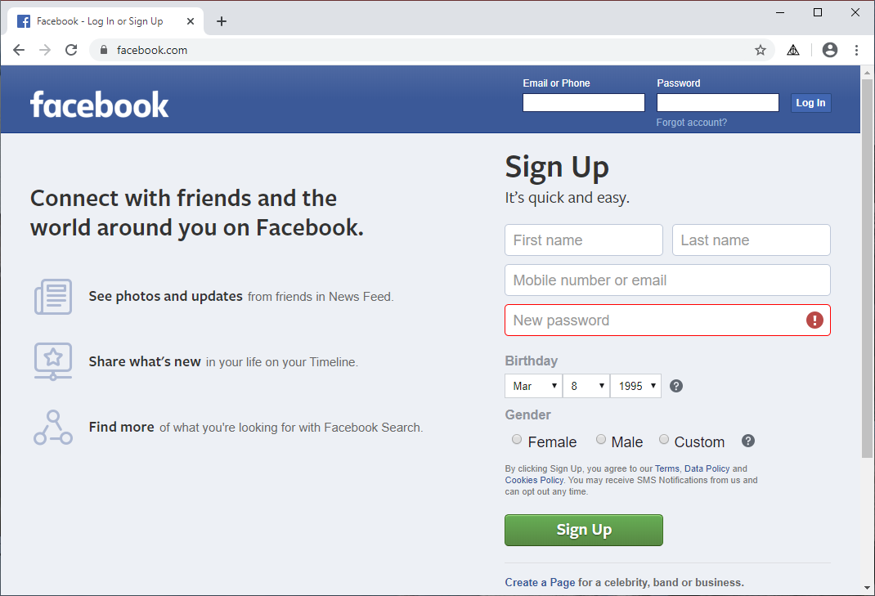
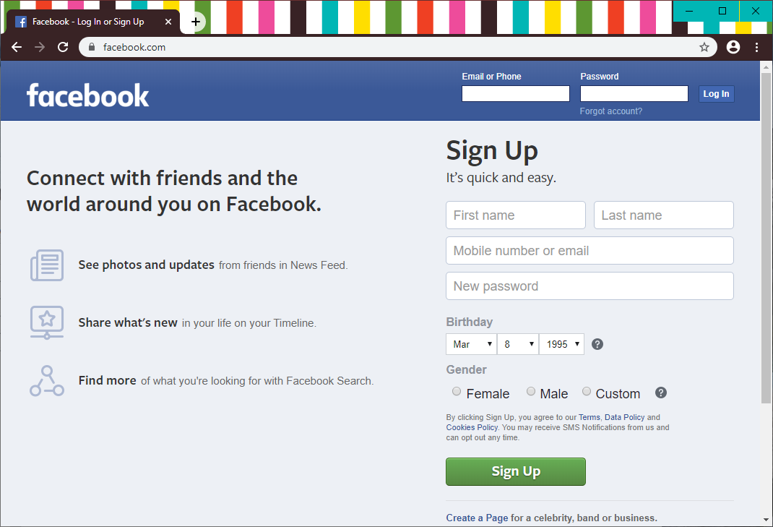
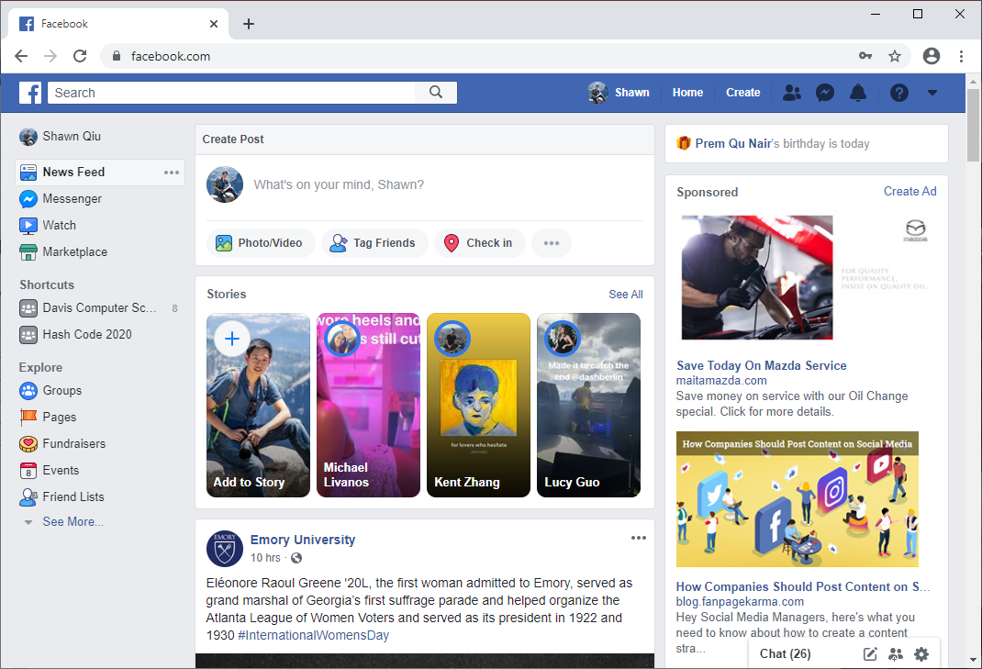
Host
Client
VNC/Remote Desktop Session
Before
Step 1: Click on Lumos extension
Launches Chrome
Step 2: Log in
VNC/Remote Desktop Session
Sends Session Cookies
After
Notes:
Make sure to watch the presentation in slide show mode. Lot’s of animations will make this slide not as cluttered

Slide 11
Lumos Components
Client
VNC Client
Host
VNC Server
Chrome Browser
Chrome Browser
Lumos Extension
Lumos Extension
Lumos Server (Node.js)

Slide 12
Lumos components are widely available and supported on many platforms

Slide 13
Security Analysis vs Fidelius
Lumos
Fidelius
Attack Surface:
Enclave
Side-channel attacks
URL/info passed to enclave
Encrypted user inputs
Attack Surface:
Enclave
Side-channel attacks
URL/info passed to enclave
Encrypted user inputs
More Secure!
Enclave does not share hardware with Host
Secure user inputs never reach Host
Notes:
The security community keeps finding new vulnerabilities in Intel SGX. Latest: March 10, 2020 - Load Value Injection. Unclear if enclaves are possible to be completely secure. Better to use separate hardware like Notary.

Slide 14
Lumos REST API
Two functions:
Send URL for Login Page
Retrieve Cookies
Notes:
Simple API – easier to secure

Slide 15
What if the thin client is compromised?
Thin clients do not need to hold persistent data and is transparent to users most of the time
Example Mitigations:
(take advantage of thin clients – little/no impact on usability)
Use the “LiveCD” model
Wipe all changes on reboot
Use OS meant for isolation
E.g. Use IBOS or Qubes OS or some derivative
No persistence for attacks
Attacks will be limited in scope
e.g. Load OS into RAMDISK
Notes:
Thin clients do not need to house information as they are not used for actual computing – we can take drastic steps to secure the thin client without affecting usability.
Wipe all changes on reboot – load OS from read-only storage (SD card with lock) into a RAMDISK
Use isolation techniques like IBOS or VMs to isolate components (e.g. Qubes OS runs almost everything in separate VMs: see appendix)

Slide 16
Lumos – Mission Accomplished!
Easier to use and setup than Fidelius
More secure
than Fidelius
More assessible/portable than Fidelius

Slide 17
Live Demo
Lumos double protection to the rescue

Slide 18
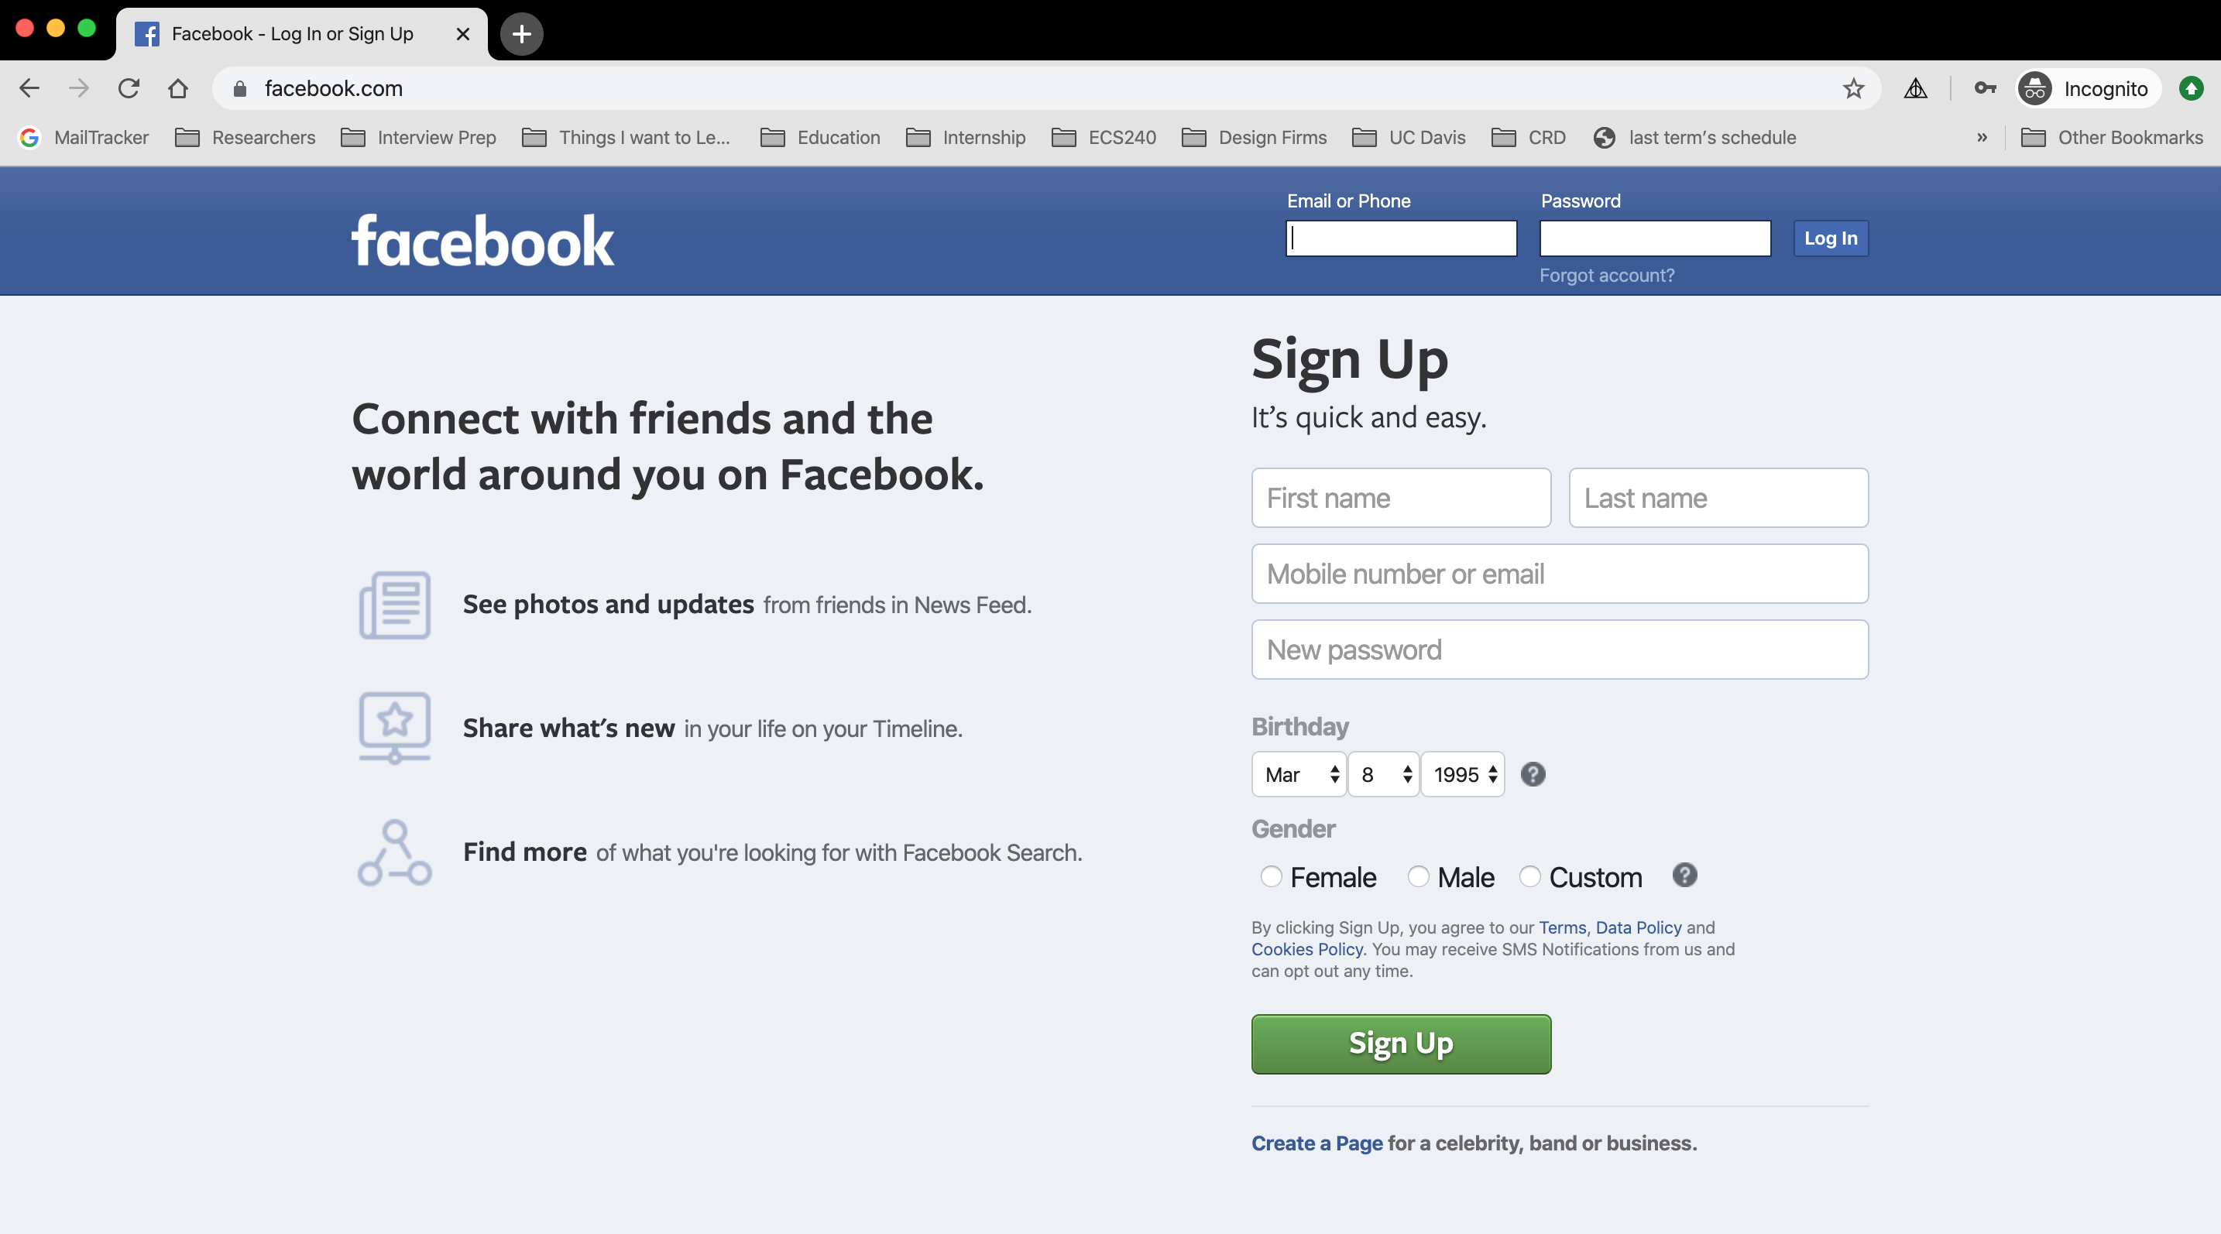
USER STUDY
Overview: Conducted a qualitative user study (n = 8)
Task: Log into Facebook with Lumos Chrome Extension
Lumos Chrome extension
Notes:
To test the usability of Lumos prototype, we conducted a user study among 8 participants. During the experiment, tutorials of Lumos Chrome extension were presented and explained to each participant first, and then they were asked to log into Facebook account with Lumos Chrome extension.

Slide 19
EMERGENT THEMES
From the user study, we found the following themes:
Logging in with Lumos is Easy
Transparency is Needed
Visual Design Affects Trust
Automate the Process (Do it for me!)
Speed is a Factor
Notes:
There are 5 emerging themes found throughout the user study:
1. Logging in with Lumos is easy
2. Transparency is needed for users to understand and trust Lumos
3. The current visual design affects user's trust towards Lumos
4. Users prefer the log in process through Lumos to be automated
5. Speed of the log in affects usability
All five themes will be discussed in the following slides.

Slide 20
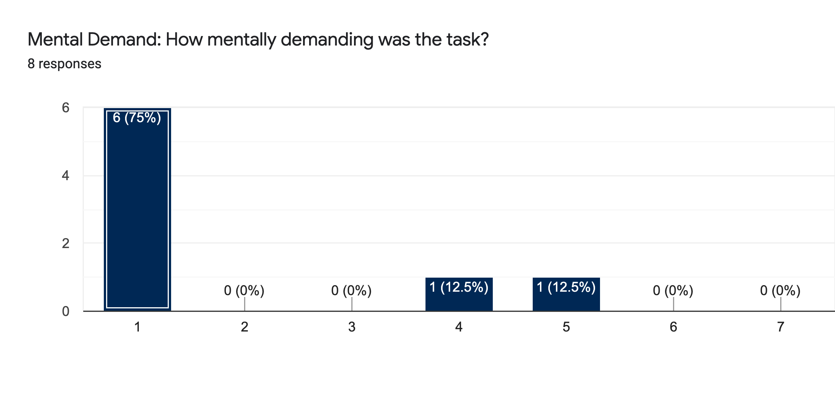
LOGGING IN WITH LUMOS IS EASY
6 out of 8 participants reported that the login task to Facebook using Lumos is not mentally demanded, suggesting that the Lumos prototype is easy to use.
Notes:
According to NASA-Task Load Index Responses, 6 out of 8 participants felt the login task to Facebook using Lumos is not mentally demanded at all, suggesting that the Lumos prototype is easy to use.

Slide 21
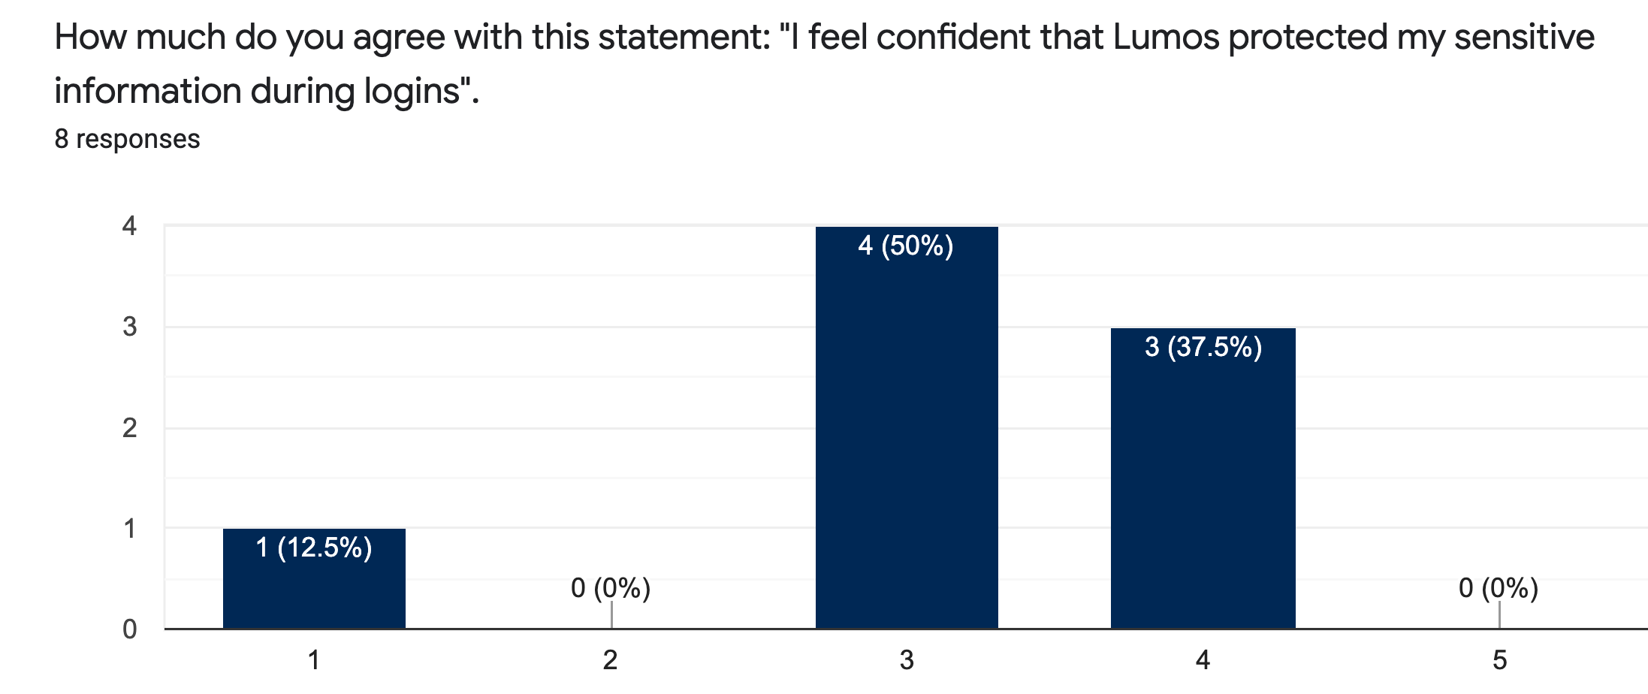
TRANSPARENCY PLEASE
All users have made a comment on wanting more transparency in terms of the back-end and architecture despite the tutorial
P3: "I felt neutral (that my information was protected by Lumos) because I do not know the background algorithm."
P6: "I don't understand the knowledge behind the scene for me to fully trust Lumos."
Notes:
Users reported that more information on back-end and architecture of Lumos would be beneficial such that they could feel more confident Lumos protected their sensitive information.

Slide 22
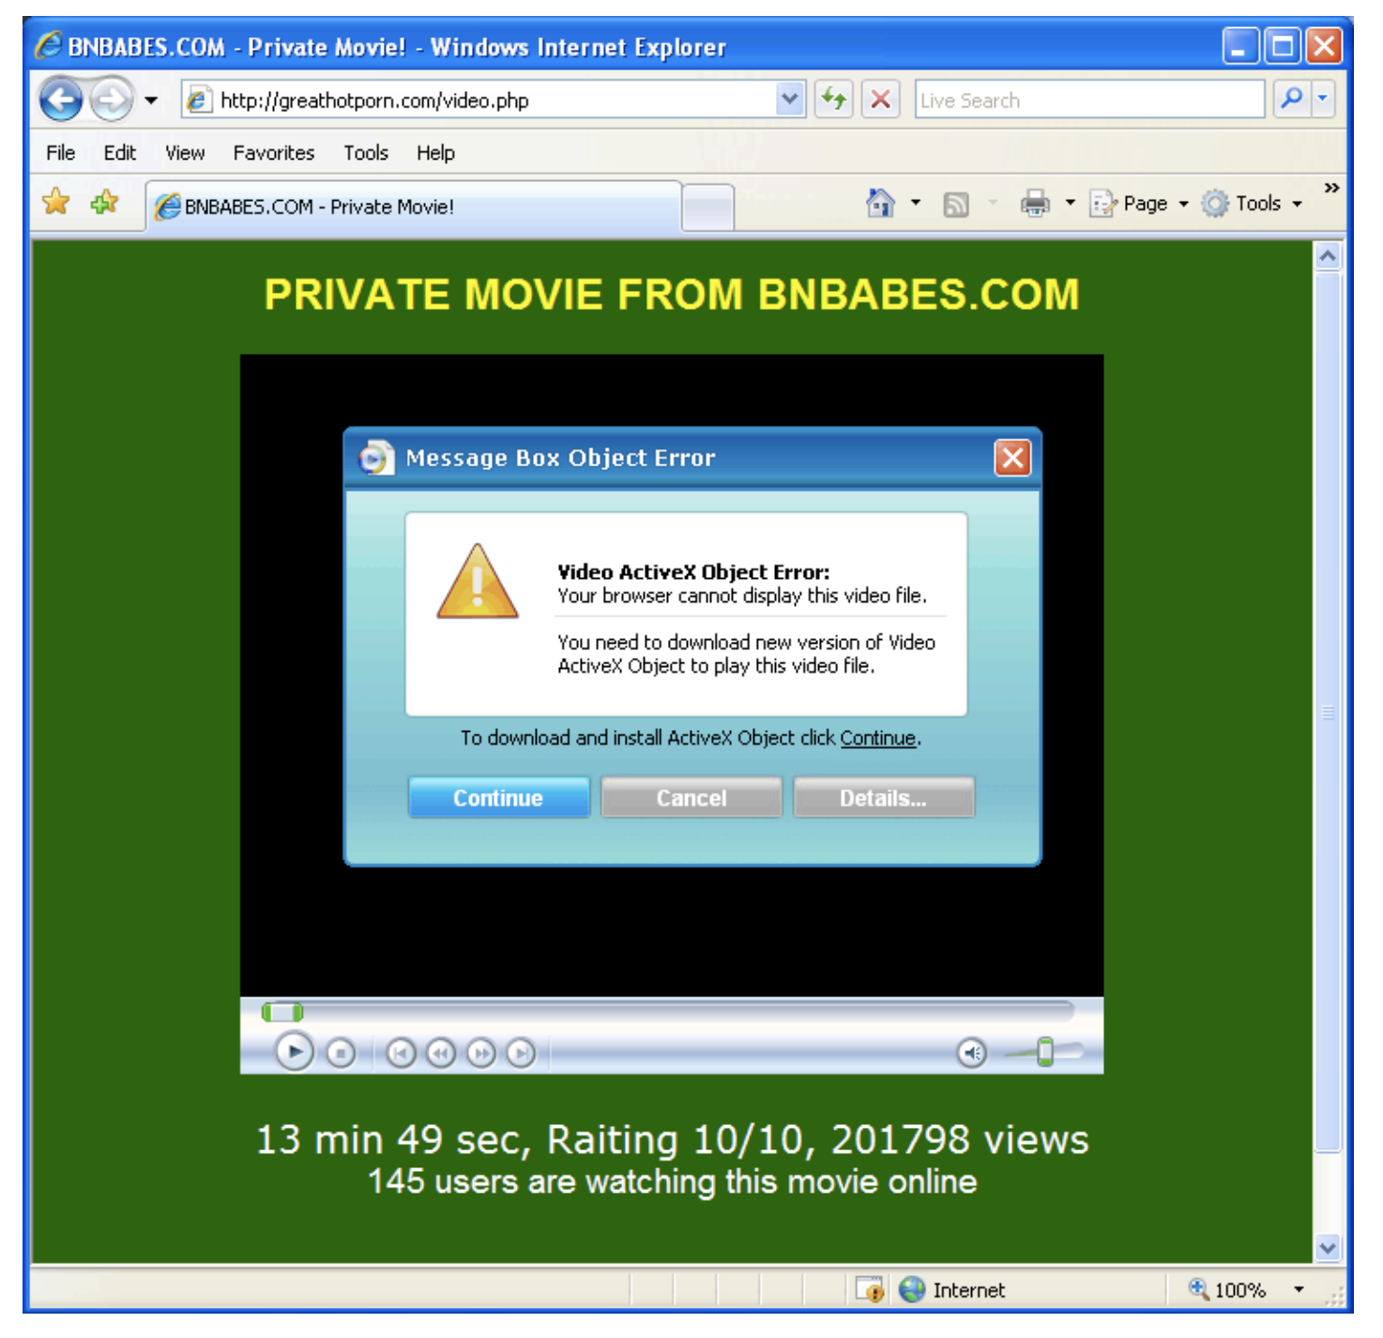
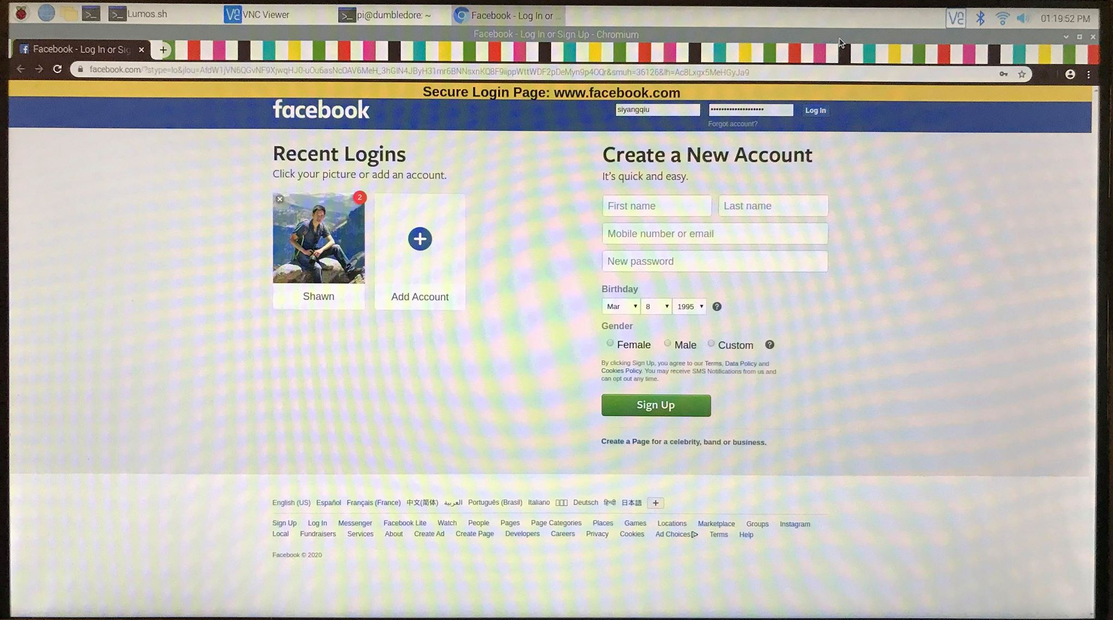
VISUAL DESIGN AFFECTS TRUST
6 out of 8 users have made a comment how the visual design of the banner affected their trust P1: "The banner looks janky and it feels a malware has injected [the banner] to my HTML"
Lumos
greathotporn.com [2]
[2] Sam King's 1/15 slides
Notes:
Most participants commented that Lumo's visual design of the web banner, which was meant to remind users to check the url of the login page. Participants felt that the banner was not well-intergated to the page, and the visual design (font and color) made itself look suspecious.

Slide 23
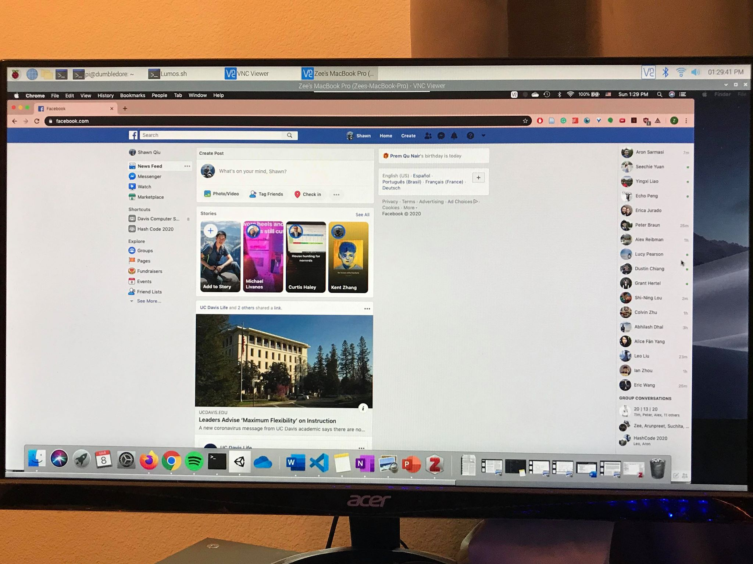
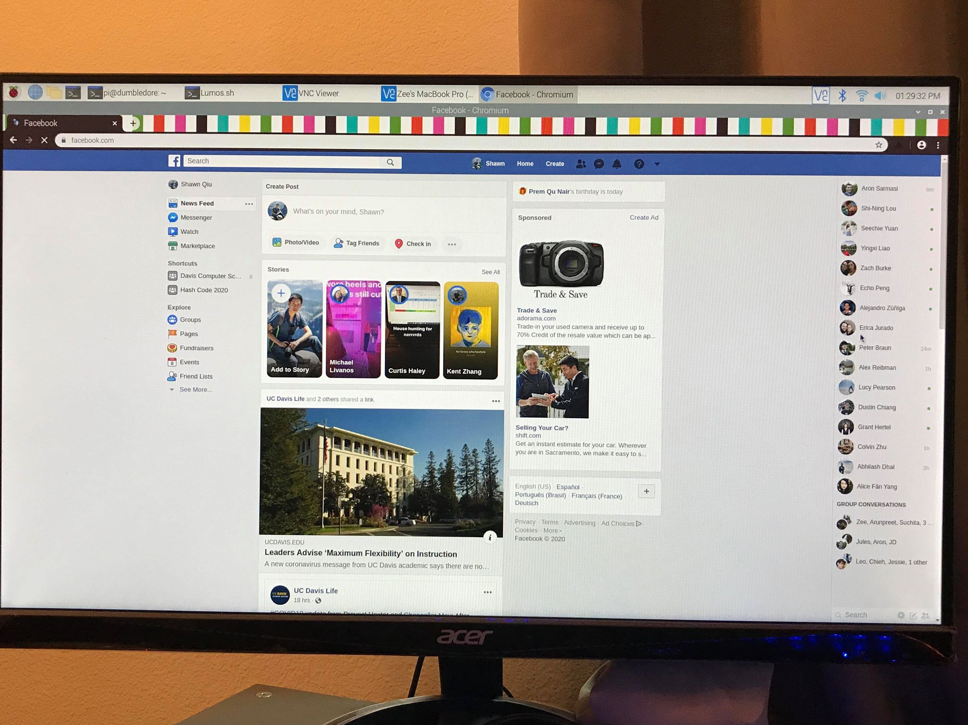
VISUAL DESIGN AFFECTS TRUST
3 out of 8 users commented on how it is not visually clear whether they're in a safe space or not P2: "Am I in the VNC or the [Raspberry] Pi?"
VNC
Raspberry Pi
Notes:
Additionally, some participants mentioned that it was not visually clear whether they were in the comprimised computer or secure Raspberry Pi. Therefore, the visual design of Lumos prototype could be improved such that users could feel secure logging in with Lumos.

Slide 24
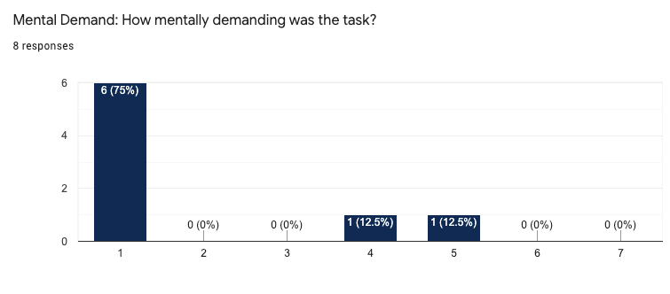
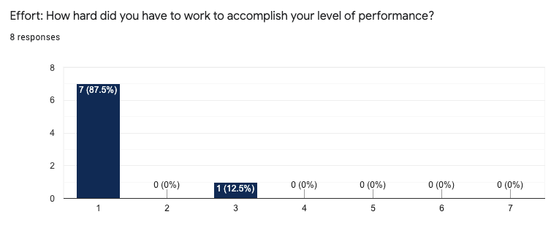
AUTOMATE THE PROCESS (DO IT FOR ME!)
5 out of 8 users provided a feedback of wanting to fully automate the login process
Matches the findings of what Leach [2], Egelman and Peer [3] have found
NASA-Task Load Index Responses
[2] Leach, John. "Improving user security behaviour." Computers & Security 22.8 (2003): 685-692.
[3] Egelman, Serge, and Eyal Peer. "Scaling the security wall: Developing a security behavior intentions scale (sebis)." Proceedings of the 33rd Annual ACM Conference on Human Factors in Computing Systems. 2015.
Notes:
Although users felt the login process was not mentally demanding, 5 out of 8 users provided a feedback of wanting to fully automate the login process.

Slide 25
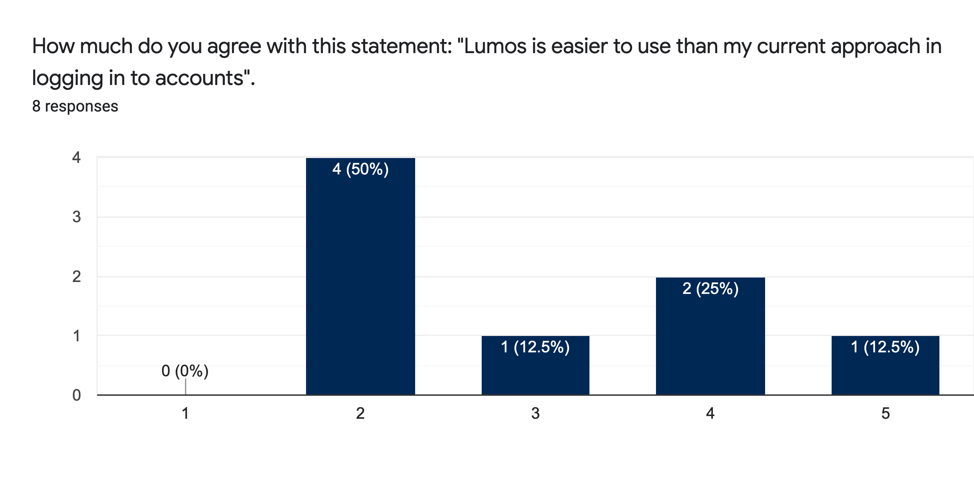
SPEED IS A FACTOR
3 out of 8 users wish the waiting time to be redirected between the compromised computer and Raspberry Pi could be faster.
5 out of 8 users felt Lumos was not easier to use compared to their current approach in logging in.
Notes:
3 out of 8 users mention the waiting time to be redirected between the compromised computer and Raspberry Pi was slow and could be improved such that Lumos could become easier to use.

Slide 26

FUTURE WORK
Automate the log-in process
Revise the visual design
Upgrade the hardware in order to provide faster experience
Provide more transparency about the algorithm
Security: Harden client OS by implementing example mitigations
Notes:
Based on the result from user study, there are four aspects we could improve user experience.

Slide 27
Questions?

Slide 28
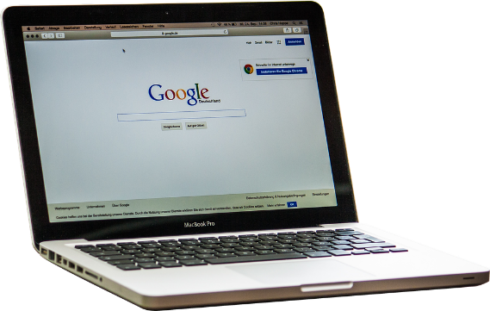
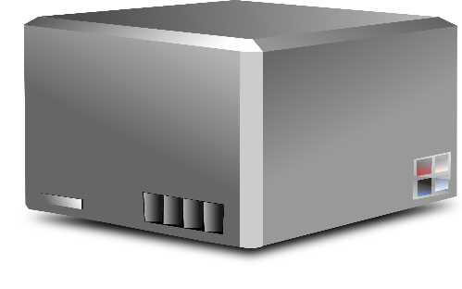
How Do Logins Work?
Initial Contact
Login Request
Contents:
Username
Password
Response
Contents:
Session Cookies
EDvF3EtimeF1583713297EuserFA21188631635A2EstateFDutF1583713297637CEchF_7bCC
Notes:
Explain how authentication works to audience who might not know

Slide 29
How Do Logins Work?
Subsequent Requests
Page Request
Contents:
Session Cookies
Response
Contents:
Page
Login Information is not sent!

Slide 30
VNC/Remote Desktop
Router
Allows a client to remotely control a computer
Transmits user inputs to host
Receives screen share of host as video feed
User Input
User Input
Display Out
Display Out
Client
Host

Slide 31
